Slide 1
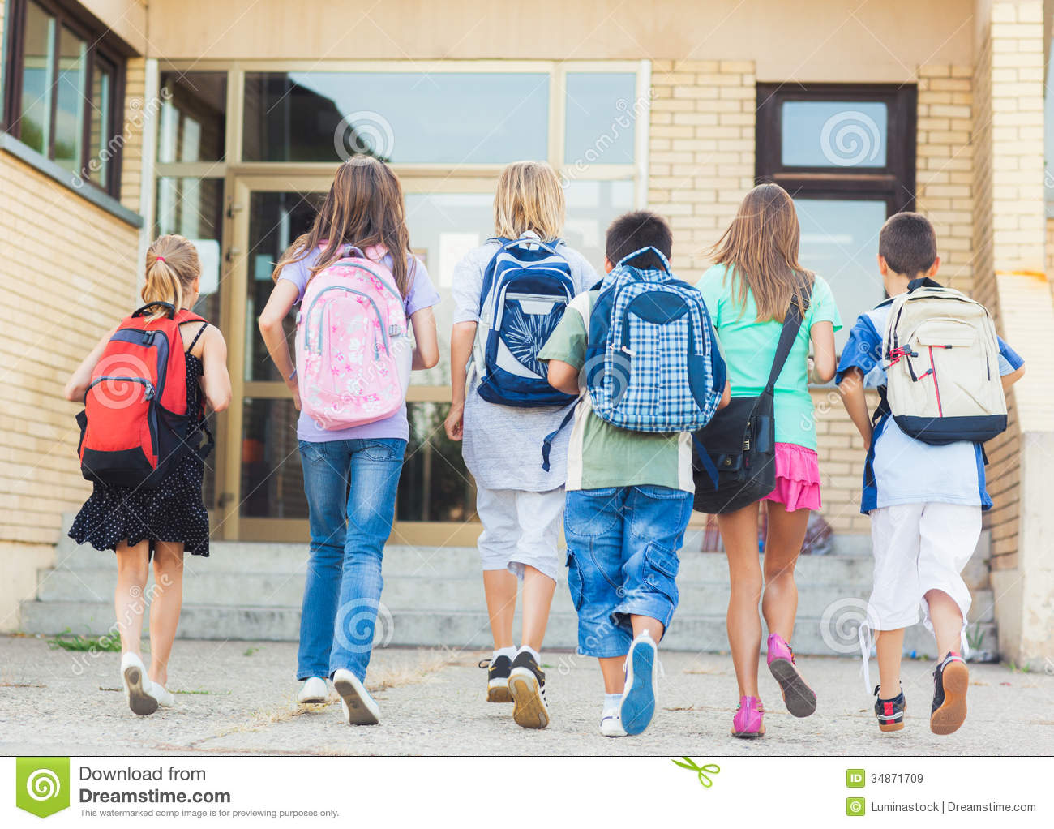
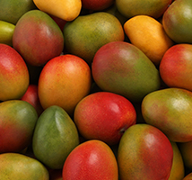
Look at the pictures and try to understand
Each of the students will get a mango.

Slide 2
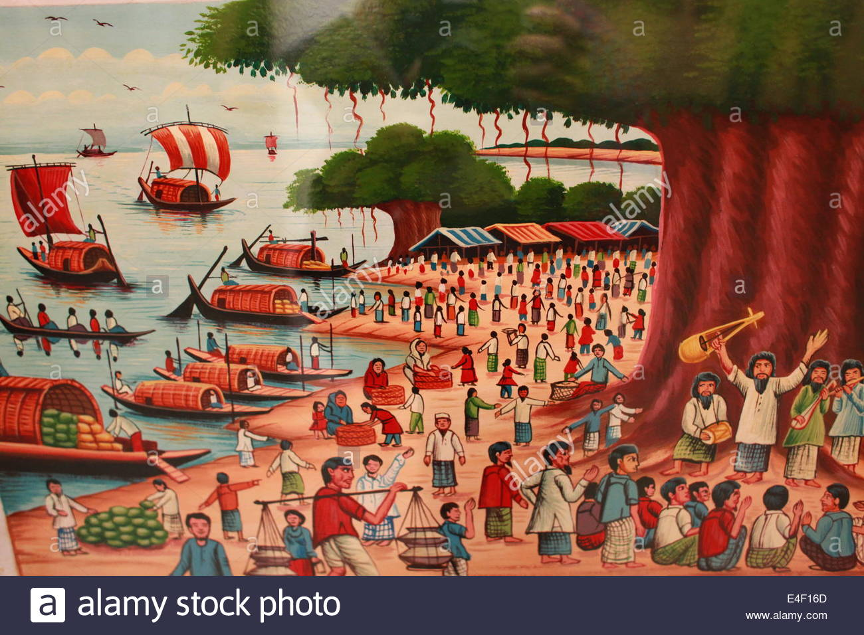
Everyone of them went to the village fair

Slide 3
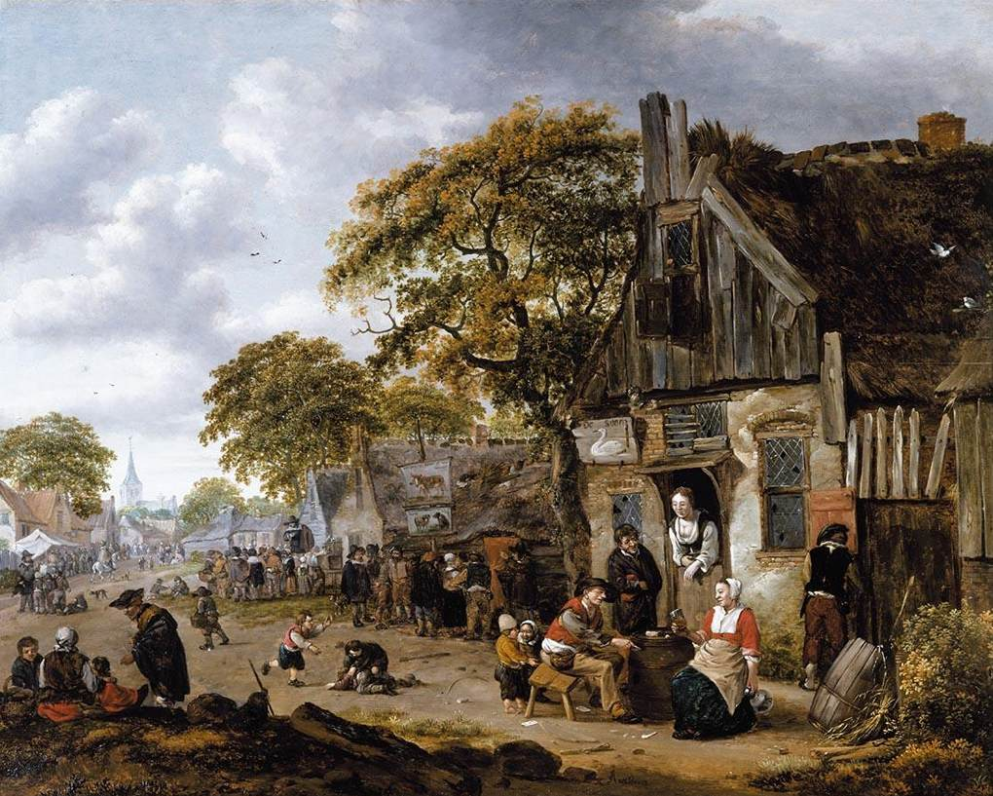
Either of the students come from village.

Slide 4

Neither of them could visit the Tajmahal.

Slide 5
5. Distributive pronoun;
A distributive pronoun separates one person or thing from a number of persons or things.
EXAMPLES
Each, Everyone, Either, Neither, None etc.

Slide 6
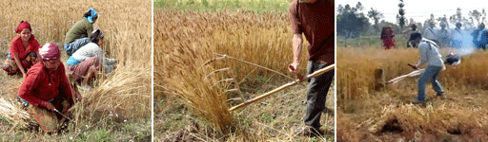
Look at the pictures and try to understand;
We should help one another to live in peace

Slide 7
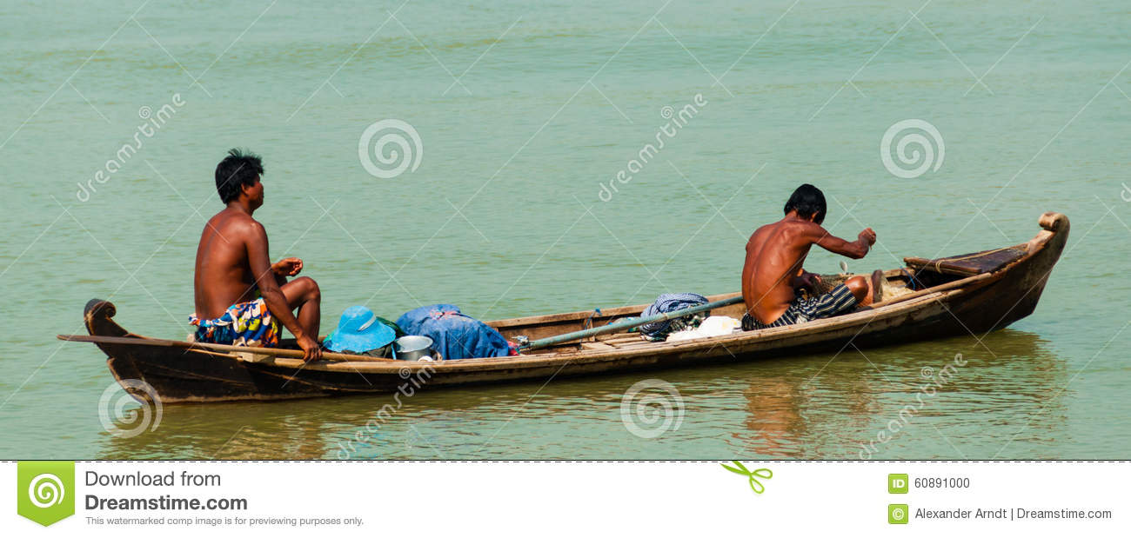
When we two work together we should help each other.

Slide 8
Reciprocal pronoun;
6.
It is used to indicate the relation between two or more persons.
Note;
1.Each other is used to indicate two persons.
2.One another is used to indicate more than two persons.

Slide 9
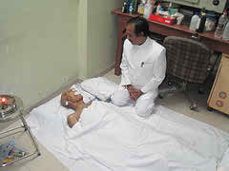
Look at the pictures and try to understand.
The man who died yesterday was my uncle

Slide 10
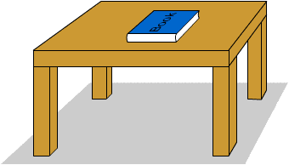
This is the book which he gave me yesterday.

Slide 11
This is the village where I was born

Slide 12

This is the house that we bought last year.

Slide 13
7. Relative pronoun;
It is used after a noun or a pronoun to show the relation with them and joins two sentences.
Note; Who, Which, That, what, whom, whose ,where
are used as relative pronoun.
EVALUATION
Join the sentences by using relative pronoun.
I saw some boys. They were playing in the field.
The boy came here. He is my brother.
Father gave me the pen. The pen writes well.
He bought a house. The house was made of bricks.

Slide 14
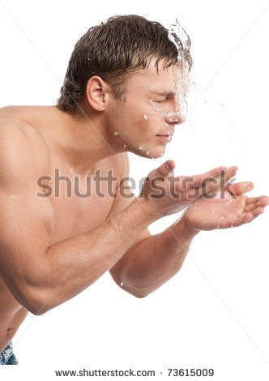
Look at the pictures and try to understand;
I wash myself when I get up.

Slide 15
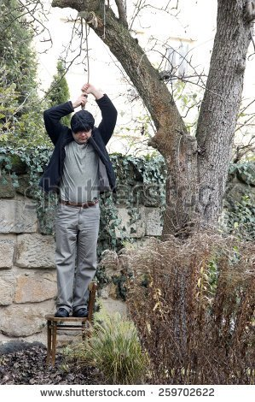
The man is hanging himself.

Slide 16
8. Reflexive /Emphatic pronoun;
Here ‘’ myself ‘’ and ‘’himself ‘’ are called reflexive pronoun because the action done by the subject turns back upon the
subject.
*When ‘’self’’ is added to my, your, him, her, it, and ‘’selves’’ to
Our, your, them, these are called reflexive/emphatic pronouns
*When myself., ourselves, itself, himself, themselves are used for the sake of emphasis these are called Emphatic pronouns.
EXAMPLES
1.I myself do the sum.
2.He himself admitted his guilt.
3.They themselves did the work.
4.The town itself is not very large.

Slide 17
EVALUATION
Fill in the following gaps with suitable pronouns.
This is the pen----he lost.
He killed------.
The rice of Barisal is better than------of Dinajpur.
------of the boys will get a prize.
-------will help you ?
I want-------of these pens.
They built the house--------.
-------can count the starts.
-------is that in your pocket ?
------is my book and------is yours.
THANK YOU

